Slide 1
Introduction to CSS
CSS is a language that works along with HTML to provide visual styles to the elements of the document, such as size, color, backgrounds, borders, etc
Attributes within HTML tags provided some essential styles to every element, but as the language evolved the code became more complicated to write and maintain and HTML alone no longer could meet the demands of web designers.
As a result, CSS soon was adopted as the way to separate structure from presentation.

Slide 2
Cascading Style Sheets 3
Cascading Style Sheets 3 (CSS3) that allows you to specify the presentation of elements on a web page (e.g., fonts, spacing, sizes, colors, positioning) separately from the document’s structure and content (section headers, body text, links, etc.).
Why CSS?
CSS saves time
Pages load faster
Easy maintenance
Multiple Device Compatibility
Global web standards

Slide 3
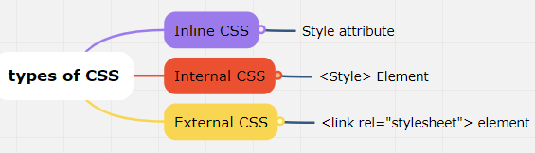
Types of CSS
Inline CSS: Inline CSS are directly applied on the HTML elements and it is the most prioritize CSS among these three. This will override any external or internal CSS.
Internal CSS: Internal CSS are defined in the HTML head section inside of <style> tag to let the browser know where to look for the CSS.
External CSS: External CSS are defined in a separate file that contains only CSS properties, this is the recommended way to use CSS when you are working on projects. It is easy to maintain and multiple CSS files can be created and you can use them by importing it into your HTML document using HTML <link> tag.

Slide 4
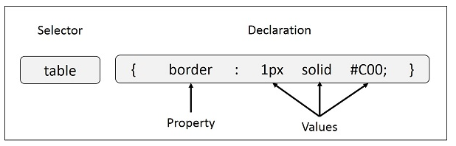
Syntax
table{ border :1px solid #C00; }
Selector − A selector is an HTML tag at which a style will be applied.
-- This could be any tag like <h1> or <table> etc.
Property − A property is a type of attribute of HTML tag.
Put simply, all the HTML attributes are converted into CSS properties. They could be color, border etc.
Value − Values are assigned to properties. For example, color property can have value
either red or #F1F1F1 etc.

Slide 5
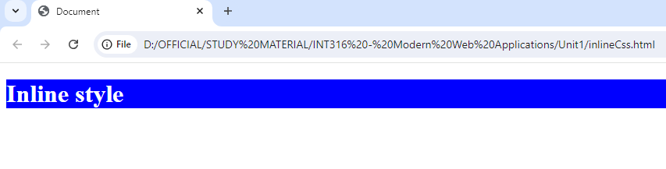
Inline Style Sheet
It is written inside the opening Tag as attribute
<p style = “color : red; background-color: blue;” > this is a text </p>
<!DOCTYPE html>
<html lang="en">
<head>
<meta charset="UTF-8">
<meta name="viewport" content="width=device-width, initial-scale=1.0">
<title>Document</title>
</head>
<body>
<h1 style="background-color: blue; color: white;"> Inline style </h1>
</body>
</html>
output

Slide 6
Internal CSS
<!DOCTYPE html>
<html lang="en">
<head>
<meta charset="UTF-8">
<meta name="viewport" content="width=device-width, initial-scale=1.0">
<title>Document</title>
<style>
h1 {
background-color: blue; color: white;
}
</style>
</head>
<body>
<h1> Internal style </h1>
</body>
</html>
Internal CSS are defined in the HTML <head> section inside of <style> tag
Output:
As like previous page

Slide 7
External CSS
<!DOCTYPE html>
<html lang="en">
<head>
<meta charset="UTF-8">
<meta name="viewport" content="width=device-width, initial-scale=1.0">
<title>Document</title>
<link rel="stylesheet" href= "extCss.css“ >
</head>
<body>
<h1> Internal style </h1>
</body>
</html>
extCss.css (css file)
h1 {
background-color: blue;
color: white;
}
External CSS are defined in a separate file that contains only CSS properties,

Slide 8
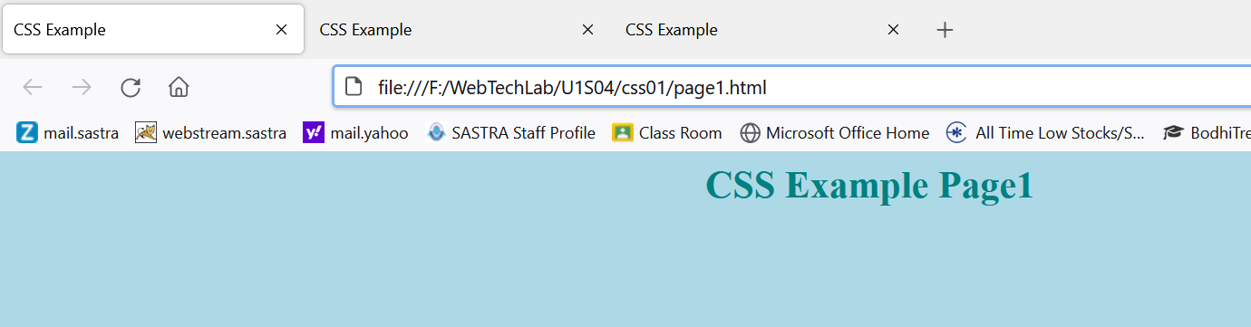
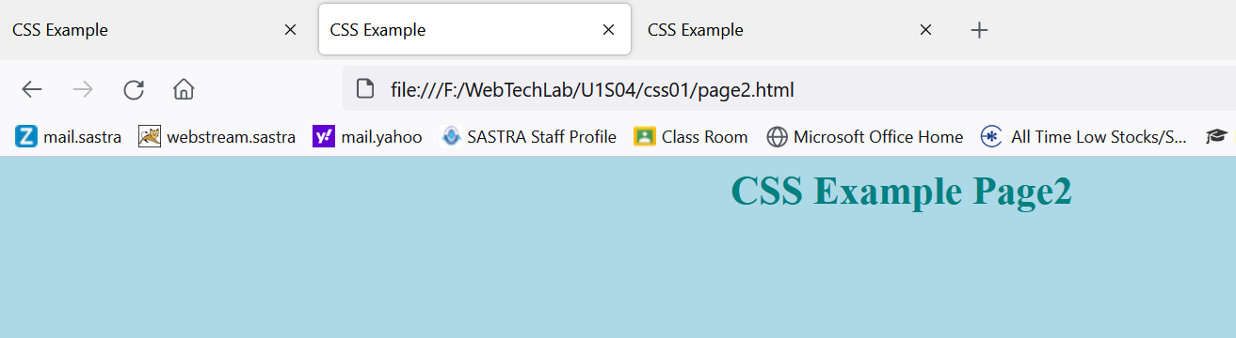
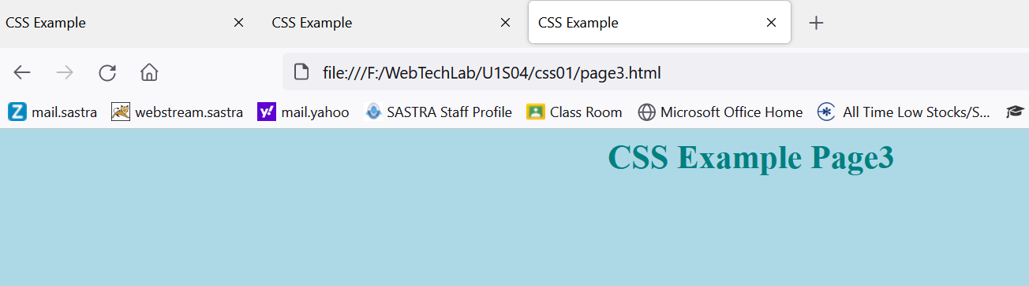
Simple Example
body{
background-color: lightblue;
}
h1 {
color: teal;
text-align: center;
}

Slide 9
Types of Selector
Universal Selectors
Element Selectors
Class Selectors
Id Selectors
Attribute Selectors
Group Selectors
Pseudo-element Selectors
Pseudo-class Selectors
Descendant Selectors
Child Selectors
Adjacent Sibling Selectors
General Sibling Selectors

Slide 10
Types of Selector
The Universal Selectors
Rather than selecting elements of a specific type, the universal selector quite simply matches the name of any element type −
* { color: #000000; }
selector

Slide 11
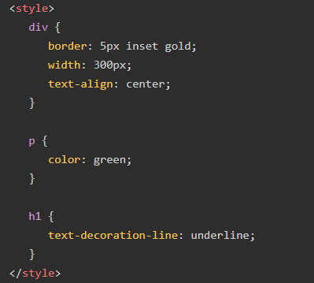
Element Selector
CSS Element Selector
A element selector targets an HTML element, such as <h1>, <p>, etc. This is used when we want to apply similar style to all the <p> tags or <h1> tags in the document.

Slide 12
Class Selector
CSS Class Selector
A class selector targets an element with a specific value for its class attribute to style it. A class in CSS is denoted by "." (period) symbol.
.sideDiv {
text-decoration-line: underline;
}
.topDiv {
color: green; font-size: 25px;
}
<div class="topDivs"> Hello World </div>
<div class=“sideDiv"> Learn CSS </div>

Slide 13
ID selector
An ID selector targets single element with a particular value for id attribute to style it. An id in CSS is denoted by "#" (hash) symbol.
<style>
#id_design
{
color: green;
font-style: italic;
}
.class_design
{
color: red;
font-family: Verdana;
}
</style>
<body>
<h1 id="id_design">example for tag with ID property</h1>
<h2 class="class_design">this is another tag</h1>
</body>
</html>
Id – Assigns a unique identifier to an element
Class- Assigns the same identifier to a group of elements.

Slide 14
Attribute Selector
An attribute selector targets an element based on a specific attribute or attribute values on an element.
<style>
a[href]
{
font-size: 2em;
}
a[target]
{
background-color: peachpuff;
color: blueviolet;
}
a[target="_self"]
{
background-color: black;
}
</style>
<body>
<h2>Attribute selector</h2>
<p> Styling applied to anchor element: </p>
<a href="https://www.tutorialspoint.com/"> Tutorialspoint </a> <br><br>
<a href="/html/index.htm" target="_blank"> HTML Tutorial </a> <br><br>
<a href="/css/index.htm" target="_self"> CSS Tutorial </a>
</body>

Slide 15
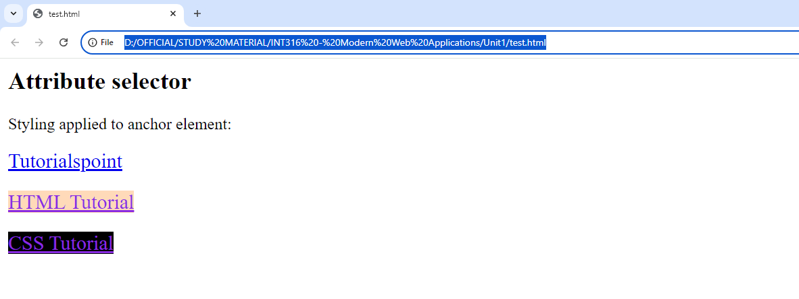
Output

Slide 16
Group Selector
CSS group selector allow us to apply same style to multiple elements at a time. Name of elements can be separated by commas. This method is recommended as it keep CSS concise and avoid redundancy.
/* Apply same background color for h1 and h2 */
h1, h2 { background-color: grey; }

Slide 17
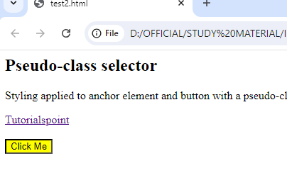
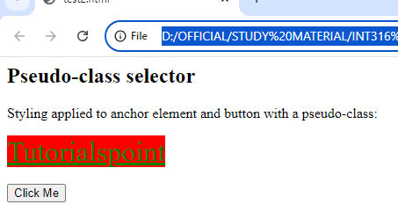
CSS Pseudo Class Selector
A pseudo-class selector is used to style a specific state of an element, such as :hover is used to style an element when hovered.
<body> <h2>Pseudo-class selector</h2>
<p> Styling applied to anchor element and button with a pseudo-class: </p>
<a href="https://www.tutorialspoint.com"> Tutorialspoint </a> <br><br>
<button>Click Me</button>
</body>
<html>
<head>
<style>
a:hover { background-color: red;
color: green; font-size: 2em; }
button:active { background-color: yellow; } </style>
</head>

Slide 18
CSS PROPERTIES

Slide 19
<p> Tag Styles
- Font properties: font-size, font-family, font-weight, font-style
- Text properties: color, text-align, text-decoration, text-transform, line-height
- Background properties: background-color, background-image
- Spacing: margin, padding
- Border properties: border-style, border-width, border-color, border-radius
- Example:
p {
font-size: 16px;
color: #333;
text-align: justify;
background-color: #f9f9f9;
padding: 10px;
border: 1px solid #ccc;
}

Slide 20
<h1> Tag Styles
- Font properties: font-size, font-family, font-weight, font-style
- Text properties: color, text-align, text-decoration, text-transform, line-height
- Background properties: background-color, background-image
- Spacing: margin, padding
- Border properties: border-style, border-width, border-color, border-radius
- Example:
h1 {
font-size: 32px;
color: #222;
text-align: center;
background-color: #e0e0e0;
padding: 20px;
border-bottom: 2px solid #444; }

Slide 21
<table> Tag Styles
- Table layout properties: width, height, border-collapse, border-spacing
- Cell properties: padding, margin, border, background-color
- Text properties: text-align, vertical-align, font properties
- Example styles for table, tr, th, td
table {
width: 100%;
border-collapse: collapse;
}
th, td {
border: 1px solid #ddd;
padding: 8px;
text-align: left;
}
th {
background-color: #f2f2f2;
}

Slide 22
<frameset> Tag Styles
- Row and column properties: rows, cols
- Frame properties: border, spacing, border-color
- Example:
<frameset rows="50%,50%">
<frame src="frame1.html">
<frame src="frame2.html">
</frameset>

Slide 23
<div> Tag Styles
- Display properties: display, float, clear
- Positioning properties: position, top, bottom, left, right, z-index
- Box model properties: margin, padding, border, box-shadow
- Background properties: background-color, background-image, background-size, background-position
div {
width: 300px;
height: 200px;
margin: 20px auto;
padding: 10px;
border: 1px solid #ccc;
background-color: #fafafa;
box-shadow: 0 0 10px rgba(0,0,0,0.1);
}

Slide 24
<form> Tag Styles
- Layout properties: display, width, height
- Form control properties: input, textarea, button styles
- Example styles for input, textarea, button
form {
width: 100%;
max-width: 600px;
margin: 0 auto;
padding: 20px;
border: 1px solid #ddd;
background-color: #f9f9f9;
}
button {
background-color: #007bff;
color: #fff;
border: none;
cursor: pointer;
}
button:hover {
background-color: #0056b3;
}
input, textarea, button {
display: block;
width: 100%;
margin-bottom: 10px;
padding: 10px;
font-size: 16px;
}

Slide 25
<img> Tag Styles
- Size properties: width, height
- Border properties: border, border-radius
- Alignment properties: float, vertical-align
- Example:
img {
width: 100%;
height: auto;
border-radius: 10px;
border: 2px solid #ddd;
float: left;
margin-right: 10px;
}

Slide 26
Contents
Text Properties
Colors
Sizes
Background
Borders
Shadows
Gradients
Filters
Transformations
Transitions
Animations

Slide 27
Text Properties
The commonly used text properties are:
text-align
text-decoration
text-transform
text-indent
text-justify
text-shadow
line-height
letter-spacing
word-spacing
CSS provides several properties that allows you to define various text styles such as color, alignment, spacing, decoration, transformation, etc. very easily and effectively.

Slide 28
Text Properties
Text Align:
The text-align property is used to set the horizontal alignment of the text.
Text can be aligned in four ways: to the left, right, centre or justified (straight left and right margins).
h1 {
text-align: center;
}
p {
text-align: justify;
}

Slide 29
Text Properties
Text Decoration
The text-decoration property specifies the decoration added to text, and is a shorthand property for:
text-decoration-line (required)
text-decoration-color
text-decoration-style
text-decoration: text-decoration-line text-decoration-color text-decoration-style;

Slide 30
Text Properties
Value Description
text-decoration-line Sets the kind of text decoration to use (like underline, overline, line-through)
text-decoration-color Sets the color of the text decoration
text-decoration-style Sets the style of the text decoration (like solid, wavy, dotted, dashed, double)
h1 { text-decoration: underline overline dotted red; }

Slide 31
Text Properties
Text Transformation
The text-transform property is used to set the cases for a text.
Using this property you can change an element's text content into uppercase or lowercase letters, or capitalize the first letter of each word without modifying the original text.
h1 {
text-transform: uppercase;
}
h2 {
text-transform: capitalize;
}

Slide 32
Text Properties
Text Indentation
The text-indent property is used to set the indentation of the first line of text within a block of text. It is typically done by inserting the empty space before the first line of text.
The size of the indentation can be specified using percentage (%), length values in pixels, ems, etc
p {
text-indent: 100px;
}

Slide 33
Text Properties
Letter Spacing
To set extra spacing between the characters of text.
length value : pixels, ems, etc. Also accepts negative values.
h1 {
letter-spacing: -3px;
}
p {
letter-spacing: 10px;
}

Slide 34
Text Properties
Word Spacing
To specify additional spacing between the words.
Length value: pixels, ems, etc. Negative values are also allowed.
p.normal {
word-spacing: 20px;
}
p.justified {
word-spacing: 20px;
text-align: justify;
}

Slide 35
Text Properties
Line Height
To set the height of the text line.
It is also called leading and commonly used to set the distance between lines of text.
p {
line-height: 1.2;
}

Slide 36
Text Properties
Text justify
Specifies the justification method of text when text-align is set to "justify".
text-justify: auto | inter-word | inter-character | none
inter-word Increases/Decreases the space between words
inter-character Increases/Decreases the space between characters

Slide 37
Text Properties
Text shadow
The text-shadow property adds shadow to text.
This property accepts a comma-separated list of shadows to be applied to the text.

Slide 38
Colors
Colors in CSS can be specified by the following methods:
Hexadecimal colors
Hexadecimal colors with transparency
RGB colors
RGBA colors
HSL colors
HSLA colors
Predefined/Cross-browser color names
With the currentcolor keyword

Slide 39
Colors
Hexadecimal colors
A hexadecimal color is specified with: #RRGGBB,
Here the RR (red), GG (green) and BB (blue) hexadecimal integers specify the components of the color.
All values must be between 00 and FF.
#p1 {background-color: #ff0000;} /* red */ #p2 {background-color: #00ff00;} /* green */ #p3 {background-color: #0000ff;} /* blue */

Slide 40
Colors
Hexadecimal Colors With Transparency
A hexadecimal color is specified with: #RRGGBB.
To add transparency, add two additional digits between 00 and FF.
#p1a {background-color: #ff000080;} /* red transparency */ #p2a {background-color: #00ff0080;} /* green transparency */ #p3a {background-color: #0000ff80;} /* blue transparency */

Slide 41
Colors
RGB Colors
An RGB color value is specified with the rgb() function, which has the following syntax:
rgb(red, green, blue)
Each parameter (red, green, and blue) defines the intensity of the color and can be an integer between 0 and 255 or a percentage value (from 0% to 100%).
the following values define equal color: rgb(0,0,255) and rgb(0%,0%,100%).
#p1 {background-color: rgb(255, 0, 0);} /* red */

Slide 42
Colors
RGBA Colors
RGBA color values are an extension of RGB color values with an alpha channel - which specifies the opacity of the object.
An RGBA color is specified with the rgba() function, which has the following syntax:
rgba(red, green, blue, alpha)
The alpha parameter is a number between 0.0 (fully transparent) and 1.0 (fully opaque).
#p2 {background-color: rgba(0, 255, 0, 0.3);} /* green with opacity */

Slide 43
Colors
HSL Colors
HSL stands for hue, saturation, and lightness - and represents a cylindrical-coordinate representation of colors.
An HSL color value is specified with the hsl() function, which has the following syntax:
hsl(hue, saturation, lightness)

Slide 44
Background-color
Hue is a degree on the color wheel (from 0 to 360) - 0 (or 360) is red, 120 is green, 240 is blue.
Saturation is a percentage value; 0% means a shade of gray and 100% is the full color. Lightness is also a percentage; 0% is black, 100% is white.
#p1 {background-color: hsl(120, 100%, 50%);} /* green */ #p2 {background-color: hsl(120, 100%, 75%);} /* light green */ #p3 {background-color: hsl(120, 100%, 25%);} /* dark green */ #p4 {background-color: hsl(120, 60%, 70%);} /* pastel green */

Slide 45
Size Property
The height and width properties are used to set the height and width of an element.
The height and width properties do not include padding, borders, or margins. It sets the height/width of the area inside the padding, border, and margin of the element.
The height and width properties may have the following values:
auto - This is default. The browser calculates the height and width
length - Defines the height/width in px, cm etc.
% - Defines the height/width in percent of the containing block

Slide 46
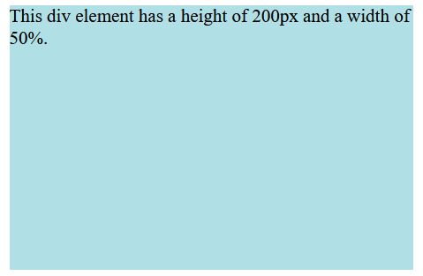
example
Example
div {
height: 200px;
width: 50%;
background-color: powderblue;
}

Slide 47
Padding & Margin
CSS Padding
The CSS padding properties are used to generate space around an element's content, inside of any defined borders.
There are properties for setting the padding for each side of an element (top, right, bottom, and left).
Padding - Individual Sides

Slide 48
CSS Padding
CSS has properties for specifying the padding for each side of an element:
padding-top
padding-right
padding-bottom
padding-left

Slide 49
CSS Padding
All the padding properties can have the following values:
length - specifies a padding in px, pt, cm, etc.
% - specifies a padding in % of the width of the containing element
inherit - specifies that the padding should be inherited from the parent element
Negative values are not allowed

Slide 50
example
<!DOCTYPE html>
<html>
<head>
<style>
div {
border: 1px solid black;
background-color: lightblue;
padding-top: 50px;
padding-right: 30px;
padding-bottom: 50px;
padding-left: 80px;
}
</style>
</head>
<body>
<h2>Using individual padding properties</h2>
<div>This div element has a top padding of 50px, a right padding of 30px, a bottom padding of 50px, and a left padding of 80px.</div>
</body>
</html>

Slide 51
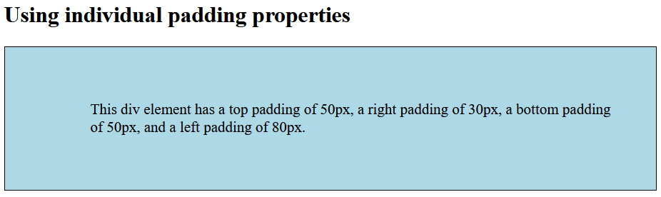
CSS Padding

Slide 52
CSS Margins
CSS Margins
The CSS margin properties are used to create space around elements, outside of any defined borders.
There are properties for setting the margin for each side of an element (top, right, bottom, and left).
Margin - Individual Sides

Slide 53
CSS Margins
CSS has properties for specifying the margin for each side of an element:
margin-top
margin-right
margin-bottom
margin-left

Slide 54
CSS Margins
All the margin properties can have the following values:
auto - the browser calculates the margin
length - specifies a margin in px, pt, cm, etc.
% - specifies a margin in % of the width of the containing element
inherit - specifies that the margin should be inherited from the parent element
Negative values are allowed.

Slide 55
example
<!DOCTYPE html>
<html>
<head>
<style>
div {
border: 1px solid black;
margin-top: 100px;
margin-bottom: 100px;
margin-right: 150px;
margin-left: 80px;
background-color: lightblue;
}
</style>
</head>
<body>
<h2>Using individual margin properties</h2>
<div>This div element has a top margin of 100px, a right margin of 150px, a bottom margin of 100px, and a left margin of 80px.</div>
</body>
</html>

Slide 56
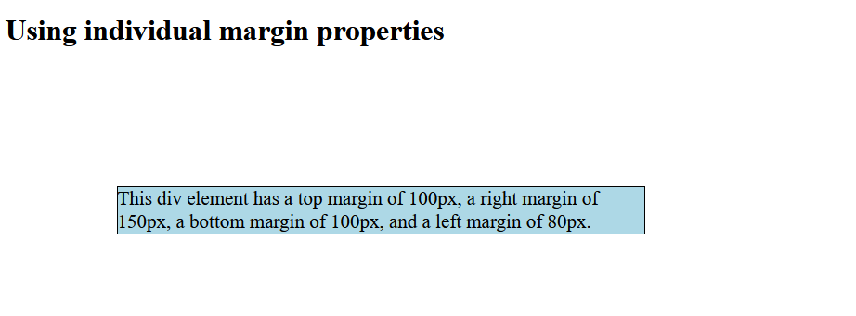
Example - output

Slide 57
CSS Margins
To shorten the code, it is possible to specify all the margin properties in one property.
If the margin property has four values:
margin: 25px 50px 75px 100px;
If the margin property has three values:
margin: 25px 50px 75px;
Top Right Bottom Left
Top Left & Right Bottom

Slide 58
Border Property
The border property is a shorthand property for the following individual border properties:
border-width
border-style (required)
border-color
Border Style
The border-style property specifies what kind of border to display.

Slide 59
Border Property
The following values are allowed:
dotted - Defines a dotted border
dashed - Defines a dashed border
solid - Defines a solid border
double - Defines a double border
groove - Defines a 3D grooved border
ridge - Defines a 3D ridged border
inset - Defines a 3D inset border
outset - Defines a 3D outset border
none - Defines no border
hidden - Defines a hidden border

Slide 60
Border color
Border color
The border-color property is used to set the color of the four borders.
The color can be set by:
name - specify a color name, like "red"
HEX - specify a HEX value, like "#ff0000"
RGB - specify a RGB value, like "rgb(255,0,0)"
HSL - specify a HSL value, like "hsl(0, 100%, 50%)"
transparent
Note: If border-color is not set, it inherits the color of the element.

Slide 61
example
<!DOCTYPE html>
<html>
<head>
<style>
.normal {
border: 2px solid red;
}
.round1 {
border: 2px solid red;
border-radius: 5px;
}
.round2 {
border: 2px solid red;
border-radius: 8px;
}
</style>
</head>
​
<body>
<h2>The border-radius Property</h2>
<p>This property is used to add rounded borders to an element:</p>
<p class="normal">Normal border</p>
<p class="round1">Round border</p>
<p class="round2">Rounder border</p>
<p class="round3">Roundest border</p>
</body>
</html>
​

Slide 62
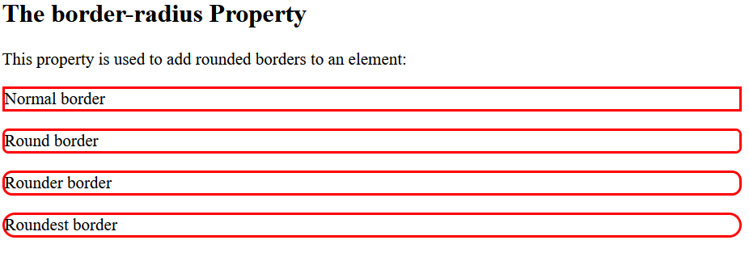
Example - output

Slide 63
Background property
Set different background properties in one declaration:
body {
background: lightblue url("img_tree.gif") no-repeat fixed center;
}
It does not matter if one of the values above are missing,
E.g.
background:#ff0000 url(smiley.gif); is allowed.

Slide 64
Background property
The background property is a shorthand property for:
background-color
background-image
background-position
background-size
background-repeat
background-origin
background-clip
background-attachment

Slide 65
Background property
Property Description
background-color Specifies the background color to be used
background-image Specifies ONE or MORE background images to be used
background-position Specifies the position of the background images
background-size Specifies the size of the background images
background-repeat Specifies how to repeat the background images
background-origin Specifies the positioning area of the background images
background-clip Specifies the painting area of the background images
background-attachment Specifies whether the background images are fixed or scrolls with the rest of the page

Slide 66
Background property
Background color
background-color: color | transparent | initial | inherit;
The background-color property sets the background color of an element.
The background of an element is the total size of the element, including padding and border (but not the margin).

Slide 67
Background property
Example: 1 background image
body {
background-image: url("paper.gif");
background-color: #cccccc;
}
Example: 2 background images
body {
background-image: url("img_tree.gif"), url("paper.gif");
background-color: #cccccc;
}

Slide 68
Background-position
Background-position
The background-position property sets the starting position of a background image.
By default, a background-image is placed at the top-left corner of an element, and repeated both vertically and horizontally.

Slide 69
Background-position
background-position: value;
Property Value Description
left top, left center, left bottom If only one keyword specified, the other value will be "center"
right top, right center, right bottom
center top, center center, center bottom
x% y% The first value is the horizontal position and the second value is the vertical. The top left corner is 0% 0%. The right bottom corner is 100% 100%. If only one value specified, the other value will be 50%. Default value is: 0% 0%
xpos ypos The first value is the horizontal position and the second value is the vertical. The top left corner is 0 0. Units can be pixels (0px 0px) or any other CSS units. If only one value specified, the other value will be 50%.

Slide 70
Background-repeat
Background-repeat
The background-repeat property sets how a background image will be repeated.
By default, a background-image is repeated both vertically and horizontally.
background-repeat: repeat | repeat-x | repeat-y | no-repeat;

Slide 71
Background-repeat
Property Values Description
repeat The background image is repeated both vertically and horizontally. The last image will be clipped if it does not fit. This is default
repeat-x The background image is repeated only horizontally
repeat-y The background image is repeated only vertically
no-repeat The background-image is not repeated. The image will only be shown once
space The background-image is repeated as much as possible without clipping. The first and last images are pinned to either side of the element, and whitespace is distributed evenly between the images
round The background-image is repeated and squished or stretched to fill the space (no gaps)

Slide 72
Background-repeat
Example:
body {
background-image: url("paper.gif");
background-repeat: repeat;
}

Slide 73
Background-origin
Background-origin
The background-origin property specifies the origin position (the background positioning area) of a background image.
This property has no effect if background-attachment is "fixed".
background-origin: padding-box | border-box | content-box;
Property Values Value Description
padding-box Default value. The background image starts from the upper left corner of the padding edge
border-box The background image starts from the upper left corner of the border
content-box The background image starts from the upper left corner of the content

Slide 74
example
Example
Set two background images for a <div> element. Let the "paper.gif" background image starts from the upper left corner of the padding edge, and let the "img_tree.gif" background image starts from the upper left corner of the content:
#example1 {
border: 10px dashed black;
padding: 25px;
background: url(img_tree.gif), url(paper.gif);
background-repeat: no-repeat;
background-origin: content-box, padding-box;
}

Slide 75

Text Shadow
Text Shadow
The CSS text-shadow property applies shadow to text.
Values for this property are, horizontal shadow, vertical shadow, blur, color.
h1 {
text-shadow: 2px 2px 5px red;
}

Slide 76

Text Shadow
Multiple Shadows
To add more than one shadow to the text, we can add a comma-separated list of shadows.
The following example shows a white text with black, blue, and darkblue shadow:
h1 {
color: white;
text-shadow: 1px 1px 2px black, 0 0 25px blue, 0 0 5px darkblue;
}

Slide 77
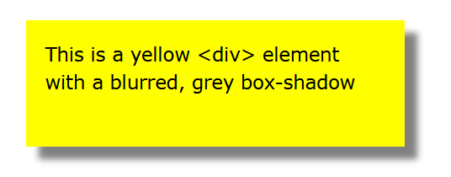
Box-shadow
Box-shadow
The CSS box-shadow property applies shadow to elements.
In its simplest use, you only specify the horizontal shadow and the vertical shadow:
div {
box-shadow: 10px 10px 5px grey;
}

Slide 78
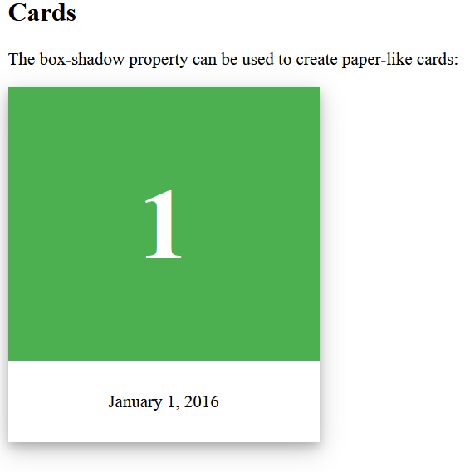
<body>
<h2>Cards</h2>
<p>The box-shadow property can be used to create paper-like cards:</p>
<div class="card">
<div class="header">
<h1>1</h1>
</div>
<div class="container">
<p>January 1, 2016</p>
</div>
</div>
</body>
</html>

Slide 79

#grad {
background-image: radial-gradient(red, yellow, green);
}

Slide 80

#grad { background-image: radial-gradient(circle, red, yellow, green); }

Slide 81

A repeating radial gradient:
#grad {
background-image: repeating-radial-gradient(red, yellow 10%, green 15%);
}

Slide 82
References
https://www.w3schools.com/css/default.asp
https://developer.mozilla.org/en-US/docs/Web/CSS

